Slide 1
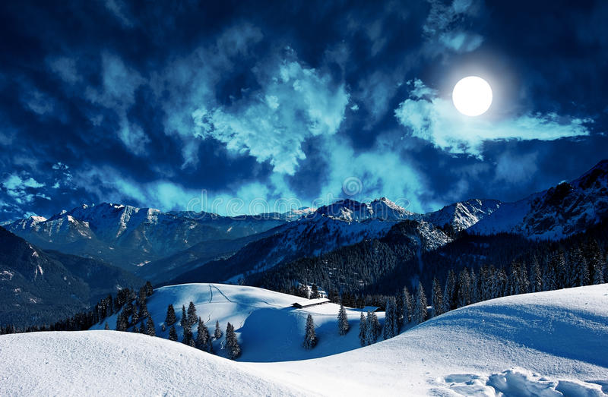
Chapter 12
First meeting with Mr Rochester

Slide 2

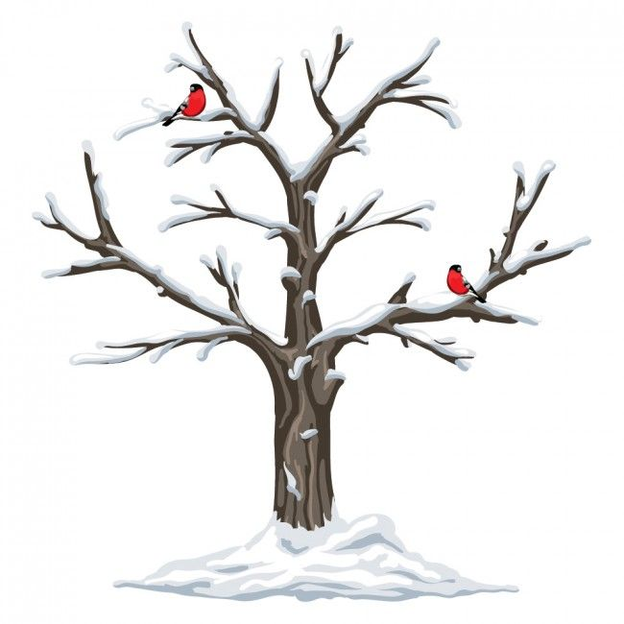
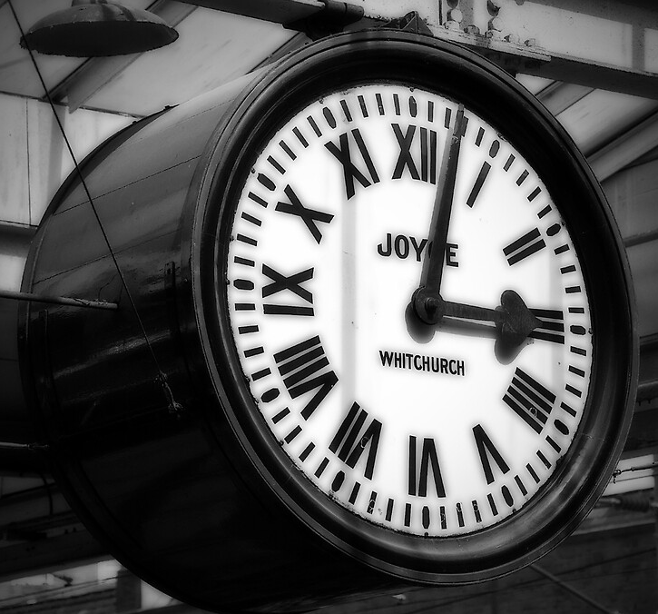
Season and time
Winter
Three o’clock

Slide 3
Three important parts
1: Death
2 : Peace
3 : Energy and violence

Slide 4

The rhythm
Allitération with the T :
“efface the aerial distance of azure hill, sunny horizon, and blended clouds where tint melts into tint”
So consonant sound
and syncopated rhythm
Suspense
for the story

Slide 5
Pathetic fallacy
Literary device that attributes human qualities and emotions to inanimate objects of nature.
Jane is boring by the sound as the Nature.

Slide 6
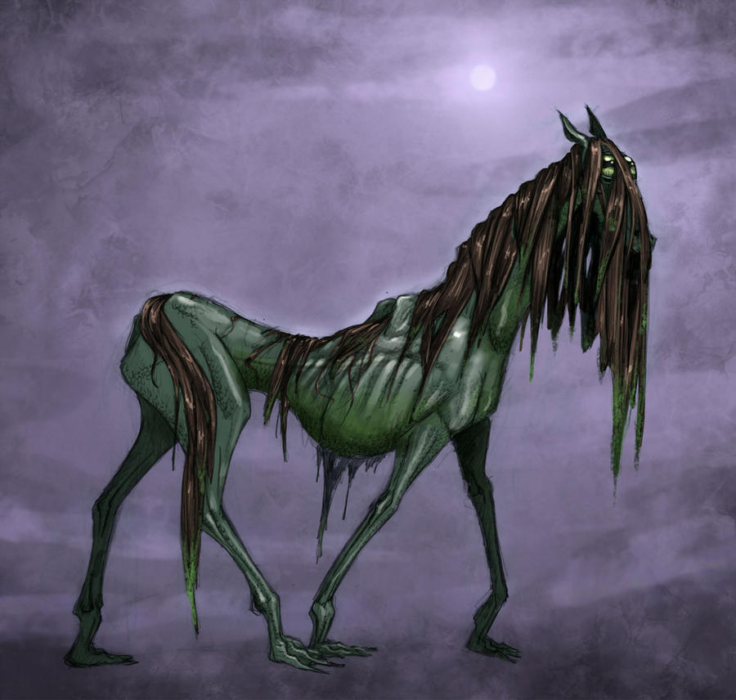
The supernatural
Bessie’s tales
Gloomy atmosphere
Gytrash

Slide 7
Sight | Sound
- seeing his master | - I heard - a sliding sound - echoed the sound

Slide 8
The two characters’ personality
Jane is helpful and daring
The man seem brave and autonomous

Slide 9
How Jane describe the rider’s physical appearance ?
- a middle-highted man
- a dark face with stern’s features, heavy brow, his eyes and gathered eyebrows looked ireful and thwarted

Slide 10
The symbols of virility
Riding cloak
Fur collared
Steel clapsed
Breadth of chest
Dark face
Stern features
Heavy brow
Thwarted eyes
Handsome, heroic-looking gentleman
I met those qualities incarnate in masculine shape
Frown, roughness

Slide 11
Characters’ conversation
A cold tone with short sentences
The readers may feel puzzled by the behaviour of Jane towards Mr. Rochester’s attitude, who is attracted by his roughness

Slide 12

Like heath that, in the wilderness,
The wild wind whirls away.
Quotation from Thomas Moore
Alliteration in -w- : Harmony
Like the wind that whirls again and again
Reader can sense it

